Slide 1
Syntax-Aware Code Completion Extension for Microsoft Small Basic in VSCode
Project Overview and Implementation

Slide 2
Background
Visual Studio Code (VSCode) is a widely used IDE with a large extension ecosystem.
Existing code completion often relies on IntelliSense and requires typing initial characters.
Small Basic and C extensions lack deep syntactic and context-aware completion.

Slide 3
VSCode Extension for Microsoft Small Basic
Aimed at enhancing coding experience in Microsoft Small Basic by integrating syntax-aware code completion.
Supports context-based suggestions without requiring initial input.
Integrates LR parsing with generative AI to suggest relevant syntax constructs.

Slide 4
Limitations of Existing Extensions
Small Basic: Only syntax highlighting, lacks IntelliSense and debugging support.
C: Requires typing multiple characters before any suggestions appear.
Copilot: Relies on comments and prompts, may generate vague or incorrect suggestions.

Slide 5
How Our Extension Addresses These Limitations
Provides syntax-aware code suggestions using LR parse states.
Offers completions without initial user input.
Displays top ranked syntax structures with explanation and structure preview.

Slide 6
Implementation Details
Developed using VSCode Extension API with TypeScript and JavaScript.
Uses YAPB-based LR parsers for Small Basic and C11 grammar.
Prompts are constructed and sent to ChatGPT for suggestion generation.
Suggestions are shown in a pop-up, and inserted into the editor upon selection.

Slide 7
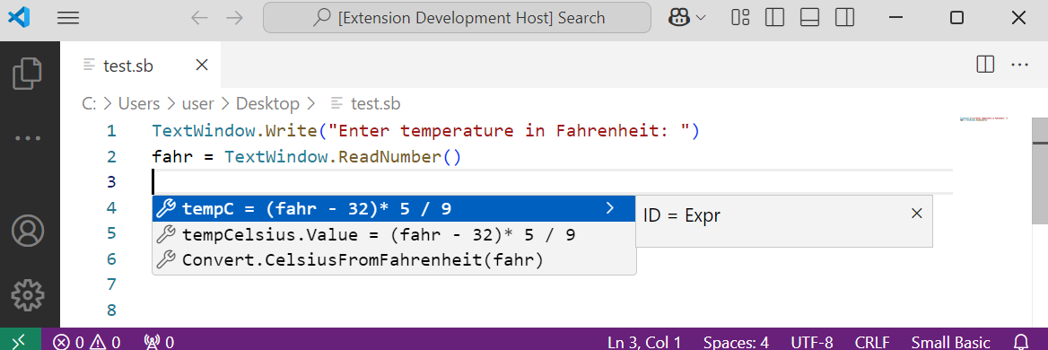
Example 1: Code Completion in Small Basic
Figure: Syntax-aware suggestion for Fahrenheit to Celsius conversion.

Slide 8
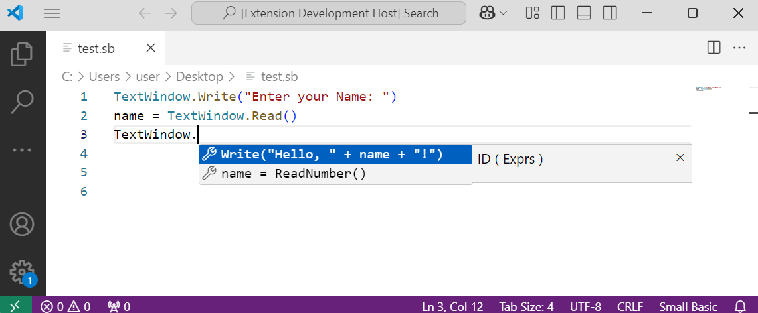
Example 2: Smart Prompt for Print Statement
Figure: Extension suggesting a full print command based on variable input.

Slide 9
Thank You

